Slide 1
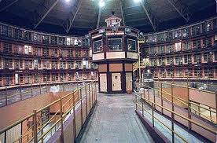
Expansion, Privatization & Profits of the Prison Industry

Slide 2
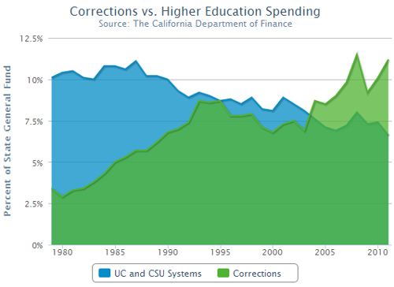

Slide 3
TRUE OR FALSE?
Over 7 million people in the U.S. are somehow connected to prison system?
TRUE

Slide 4
TRUE OR FALSE?
$810 million to build three new “Level II security” dorm complexes at existing prisons?
TRUE

Slide 5
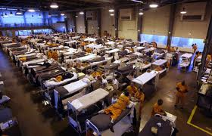
Currently there are 2.4 million people
imprisoned in the US.

Slide 6
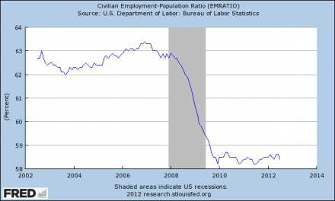
DECLINE OF EMPLOYEMENT VS.
INCREASE OF PRISON SYSTEM

Slide 7
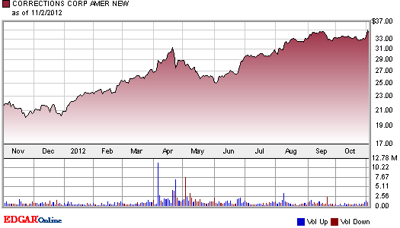
Corrections Corporation of America Stock Chart

Slide 8
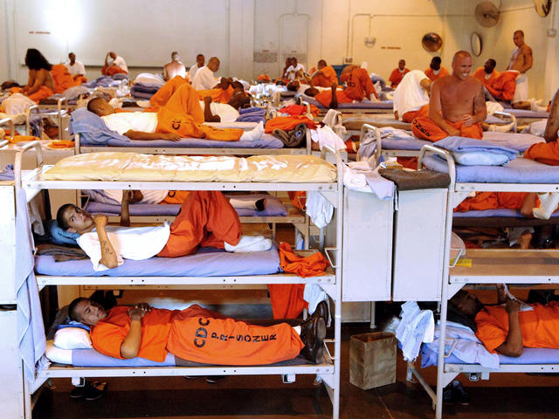
The new budget returns approximately 10,000 inmates housed in
out-of-state facilities to state prisons as beds become available

Slide 9
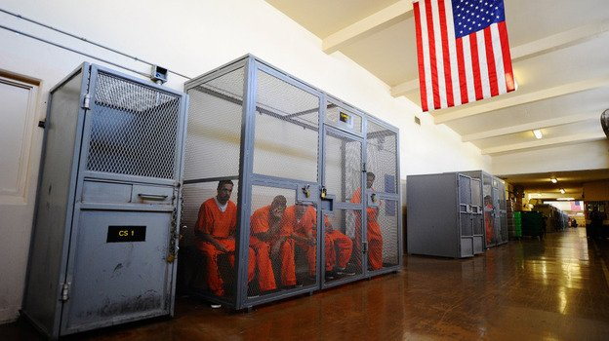
Due to overcrowding, new inmates are kept in cages.

Slide 10
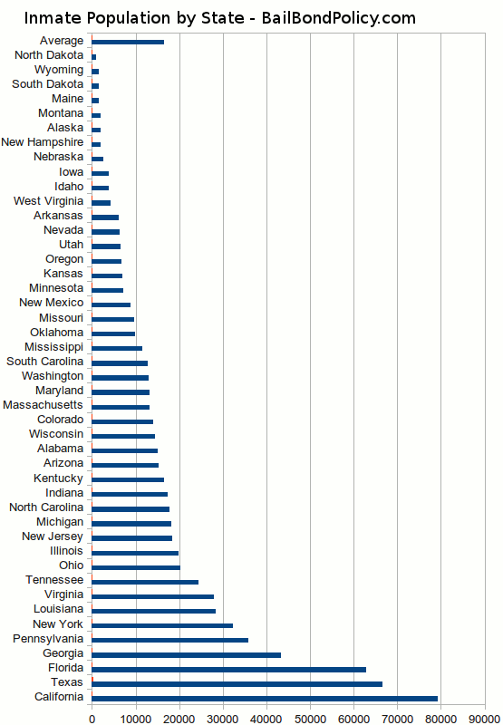

Slide 11
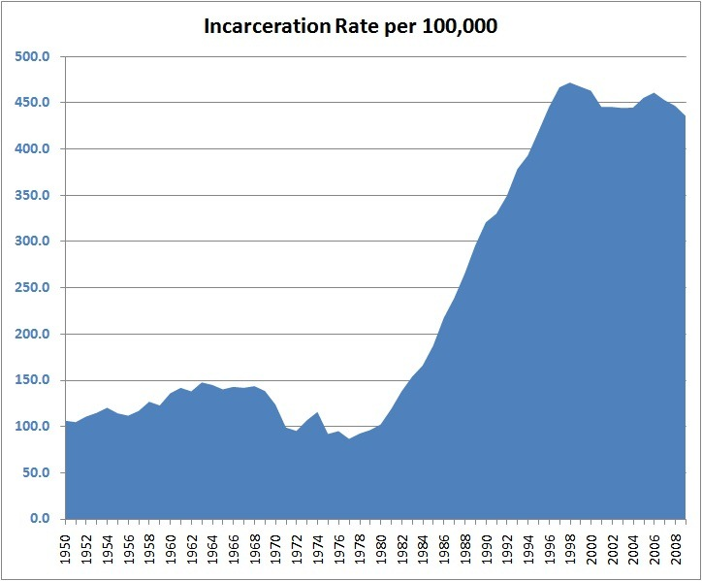

Slide 13
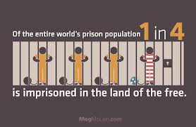

Slide 14
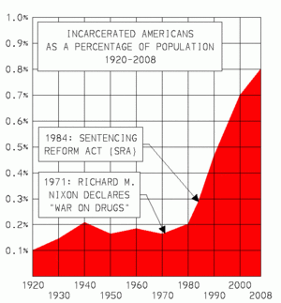

Slide 15
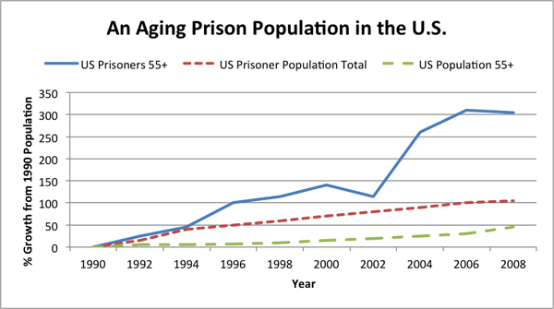

Slide 16
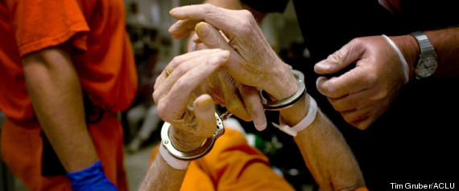
The elderly population behind the bars has soared 1, 300%
since the 1980’s
(Huffington Post)

Slide 17
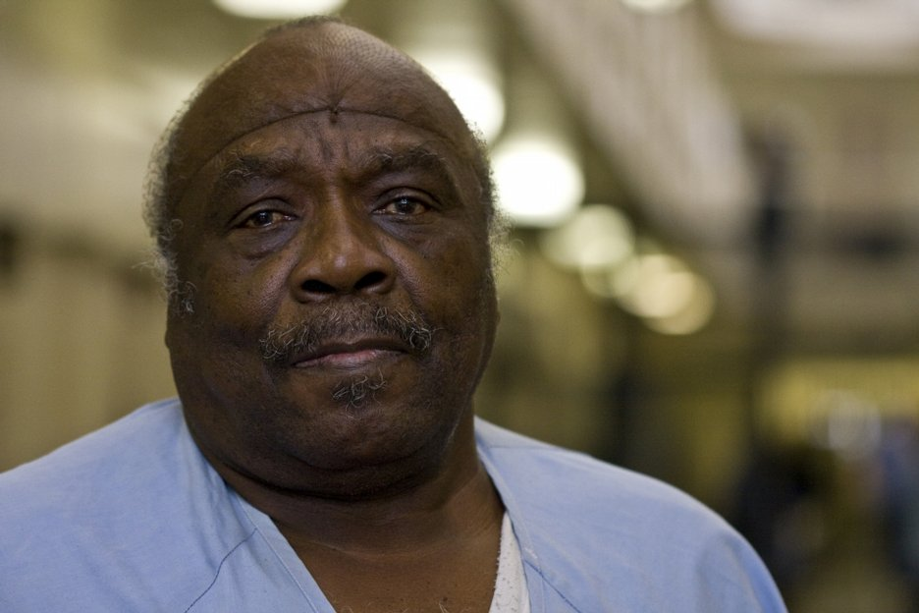
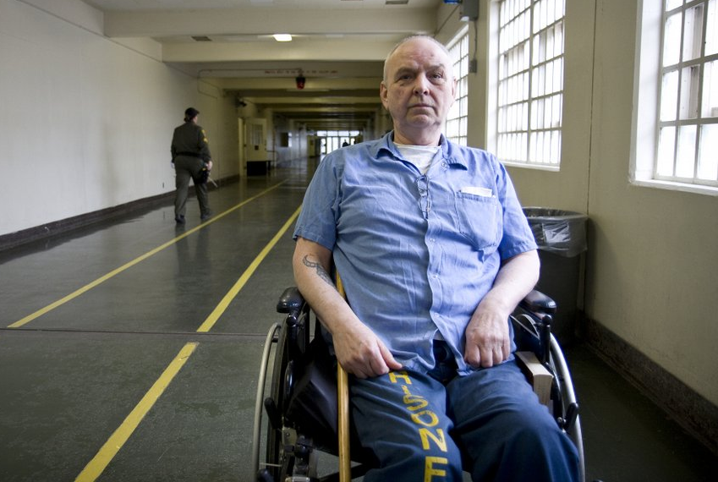
$16 billion is spent annually by states and the federal government to incarcerate elderly prisoners
These elderly people should be out with their families! Not spending their final years of life behind bars!!!

Slide 18
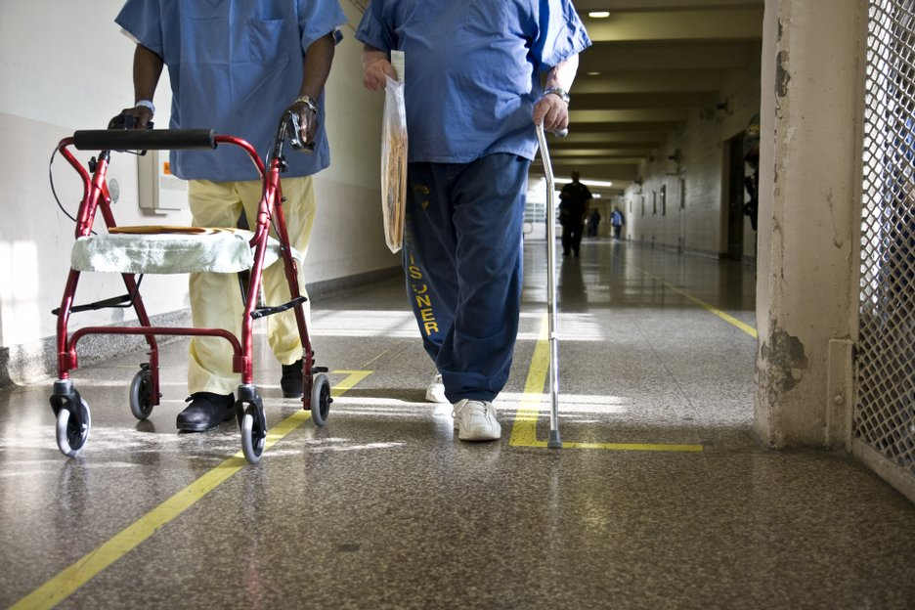

Slide 19
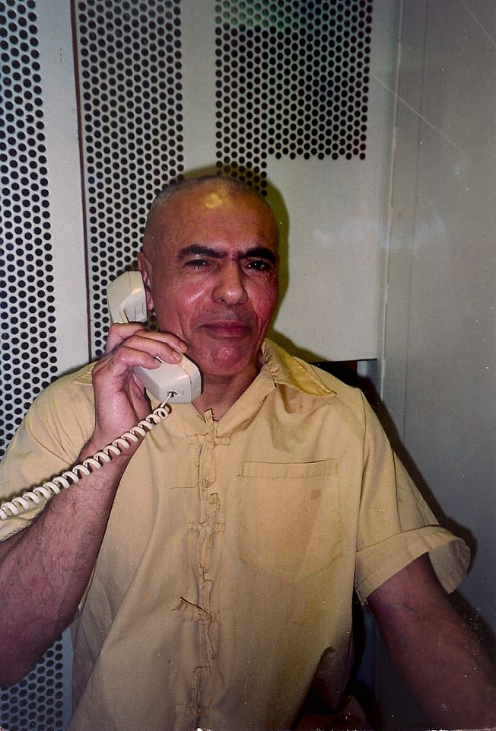
It costs on average $ 70,000 to house a Secutiy Housing Unit (SHU) inmate.
Hugo L.A. Pinell has been in the SHU for 49 years!
Total cost of his incarceration:
$3,010,000
Release Yogi NOW!!!!

Slide 20
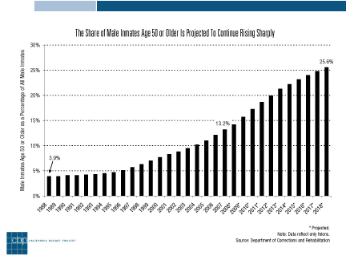

Slide 21
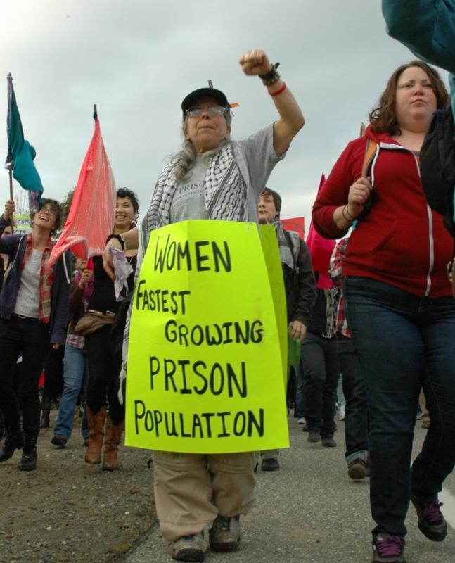

Slide 22
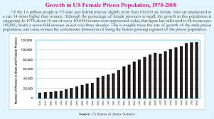

Slide 23
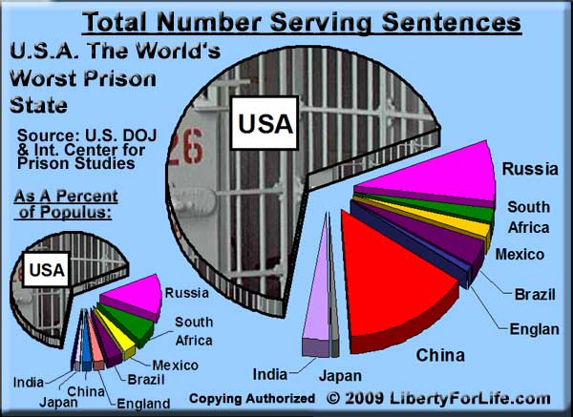

Slide 24
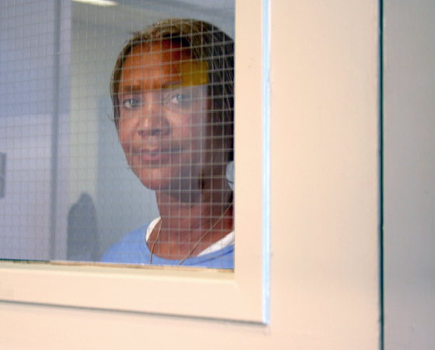
2/3 of women behind bars are survivors of domestic abuse

Slide 25
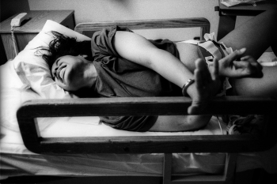
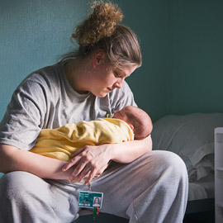
Pregnant mothers are inhumanely chained as they give birth behind the walls

Slide 26
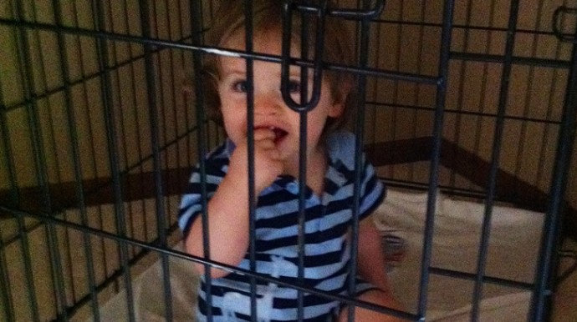
This boy has spent the first three months of his life behind razor wire and metal bars. His mother is serving a prison sentence and gave birth to her son while incarcerated. This child is one of around 80 babies currently housed with their mothers in prison, according to a new investigation by the Independent. Over 17,000 more children are separated from mothers who are in jail.

Slide 27
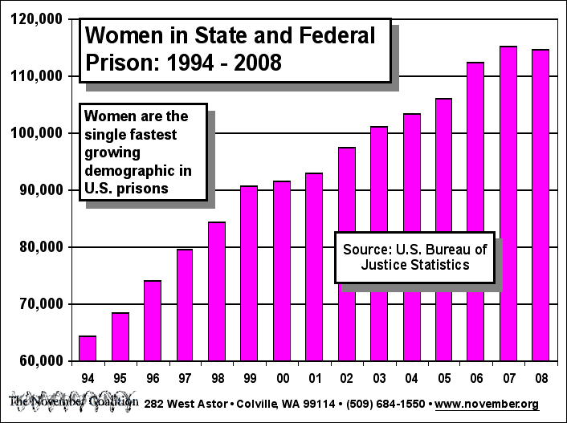

Slide 28
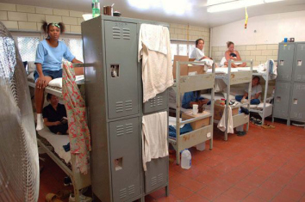

Slide 29
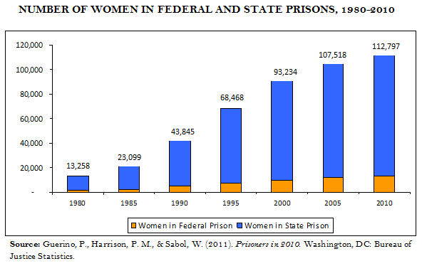

Slide 30
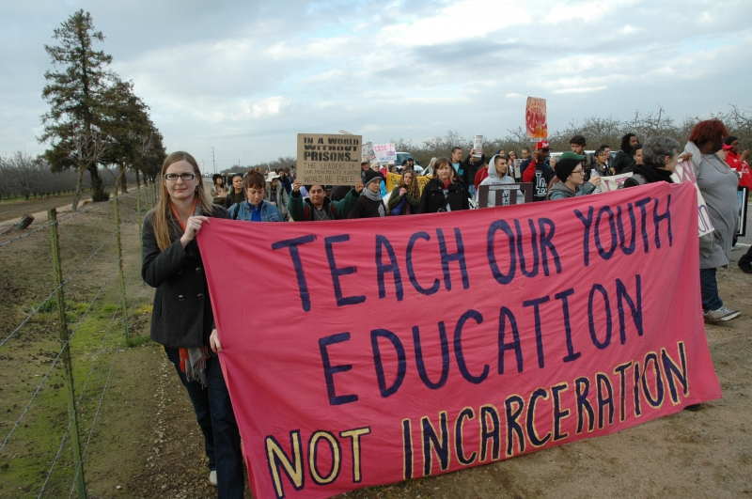

Slide 31
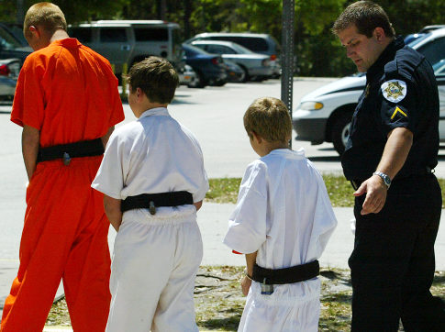
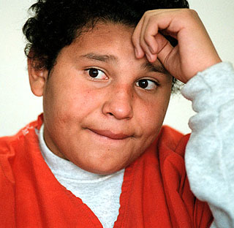
Legislators also passed AB 2312, which provided $33 million to support local juvenile justice programs. And The Juvenile Crime Enforcement and Accountability Challenge Grants gave nearly $50 million to local counties for programs and nearly $500 million to build county juvenile facilities.

Slide 32
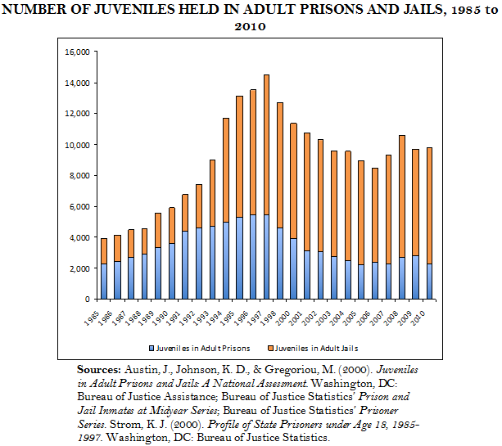

Slide 33
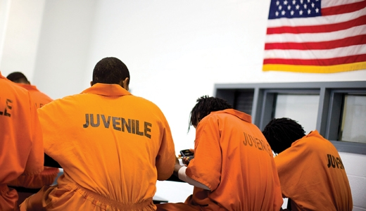
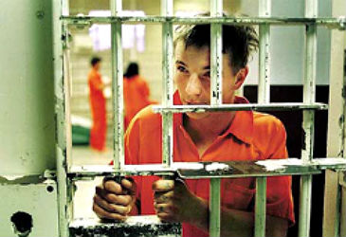
25%-30% of the youth in detention facilities do not need to be there. (Barry Krisberg)
This is NOT the way to help our youth!!

Slide 34
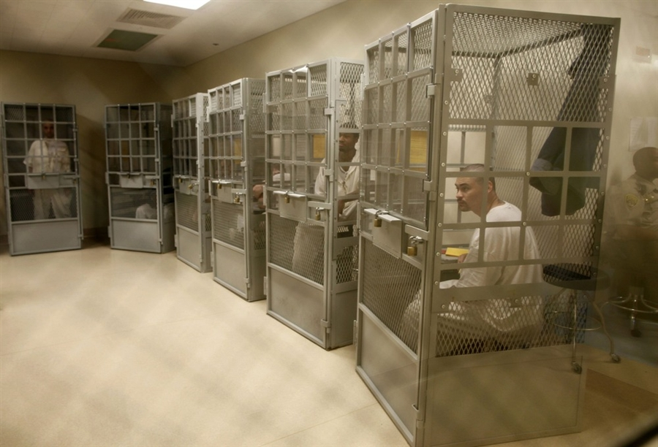
Group Therapy at San Quentin State Prison

Slide 35
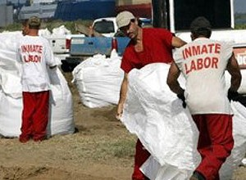
Unfortunately there is no corrections & rehabilitation, simply exploitation.

Slide 36
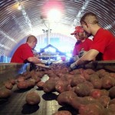
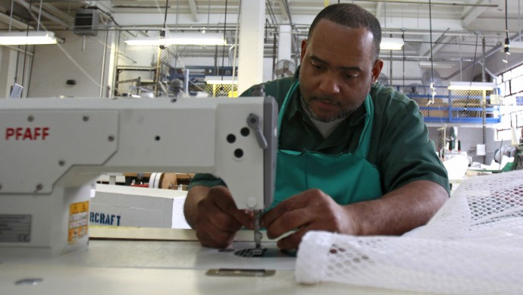

Slide 37
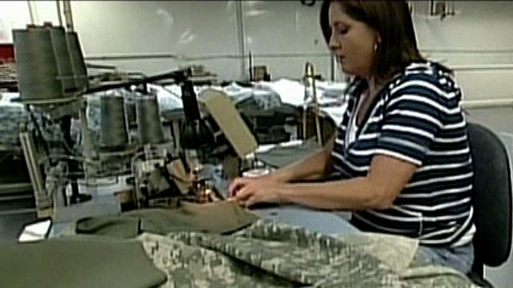
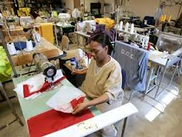
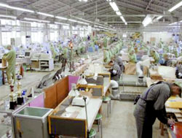

Slide 38
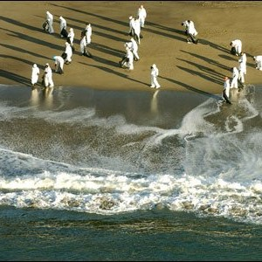
BP contracted prison labor to clean up the oil spill on the Gulf of Mexico.

Slide 39
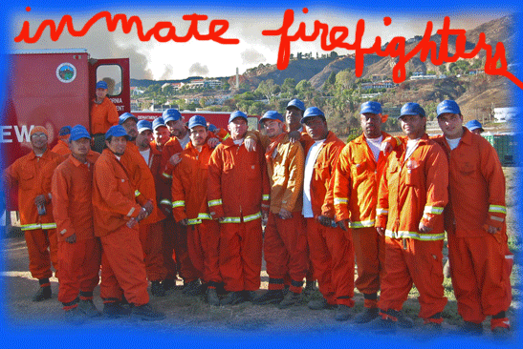
Total offender firefighters = 1,518

Slide 42
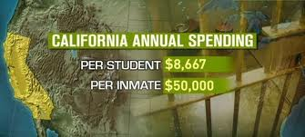
Schools NOT Jails!!

Slide 43
CONCLUSION
If we could better allocate our tax $$$ to develop our society, we could have a
much better world.

Slide 44
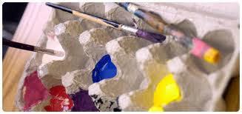
More $$$ for school supplies for our future artists

Slide 45
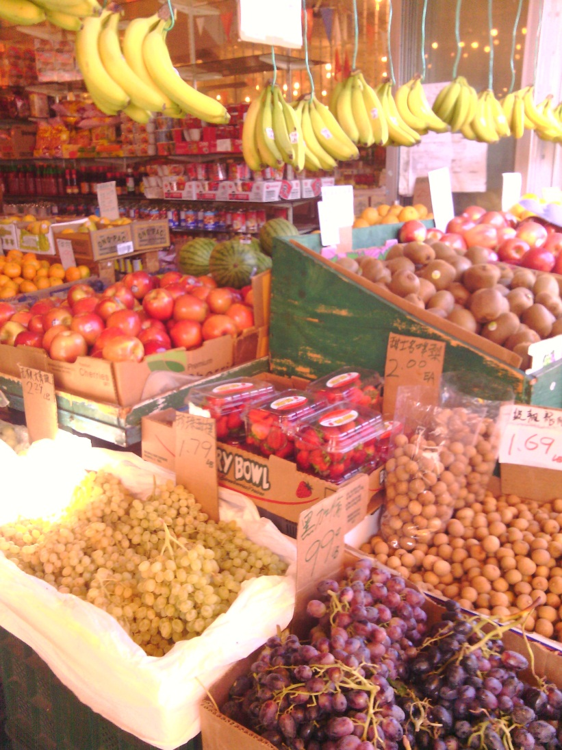
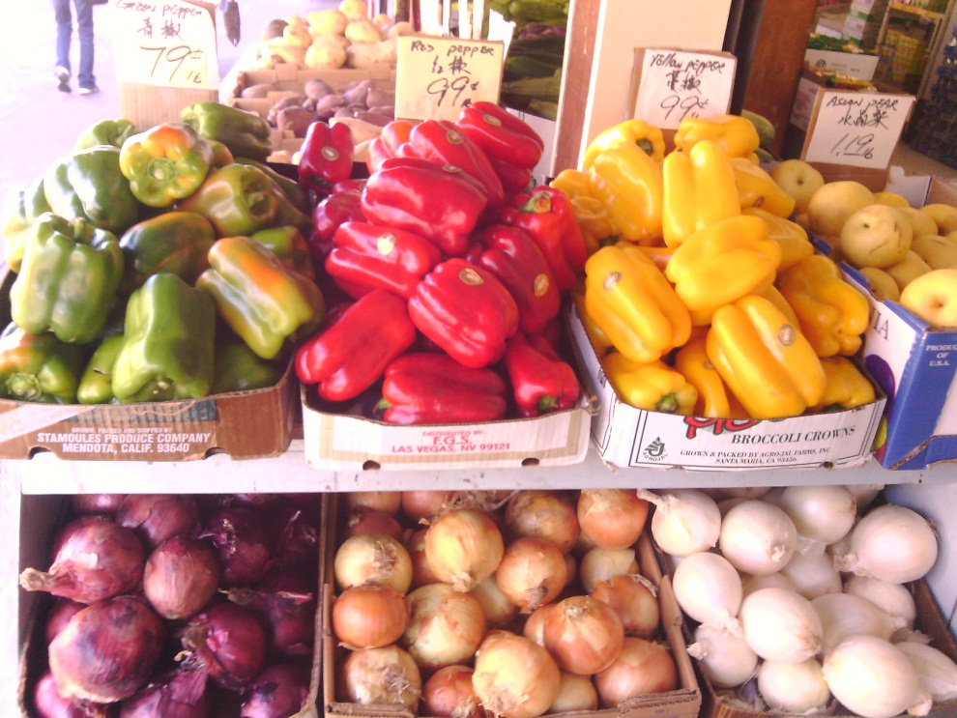
More $$$ for Organic Gardens

Slide 46
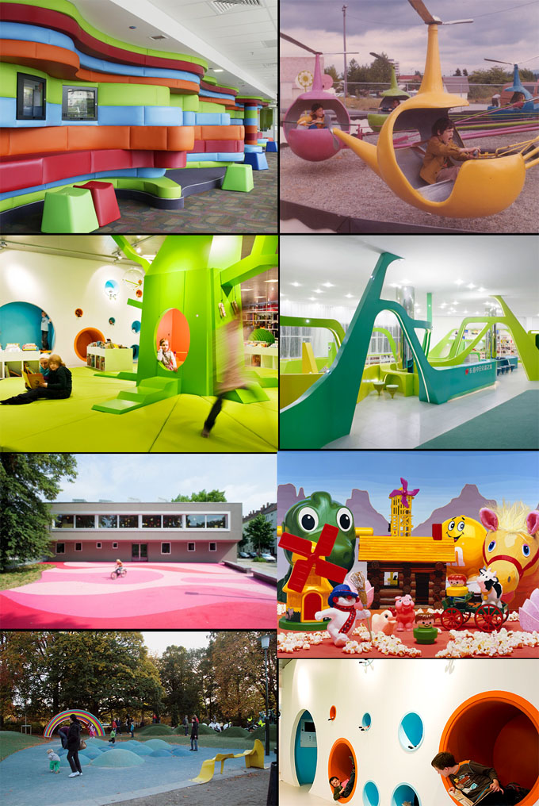
$$$ for child development especially play structures which develop the body & the mind.

Slide 47
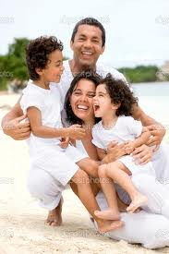
More people could have jobs and would be able to better provide for their family. That could result in a happier, more meaningful society.

Slide 48
Let’s value life more, respect & take better care of each other as well as our environment.

Slide 49
Schools NOT Jails!!!
Created by Nedzada Handukic –updated March 2013

